Slide 1
Citations: 126
Index Terms: Reinforcement Learning, Vision Language Models, Multimodal LLM, Post-Training, Medical Reasoning.
Med-R1: Reinforcement Learning for Generalizable Medical Reasoning in Vision-Language Models
Yuxiang Lai^{1*} Jike Zhong^{2*} Ming Li³ Shitian Zhao⁴ Xiaofeng Yang^{1,5†}
¹Department of Computer Science, Emory University
²Department of Computer Science, University of Southern California
³Department of Computer Science, University of Tokyo
⁴Department of Computer Science, Johns Hopkins University
⁵Department of Biomedical Engineering, Georgia Institute of Technology
arXiv:2503.13939v1 [cs.CV] 18 Mar 2025
IEEE Transactions on Medical Imaging (TMI), 2026 (Accepted)
DOI: 10.1109/TMI.2026.3661001
01/17

Slide 2
Introduction: Challenges of Current Medical VLMs
Limitations of Supervised Fine-Tuning (SFT)
Annotation Bottleneck
  Medical Chain-of-Thought (CoT) Data: High cost, expert-dependent
Shortcut Learning
  Models memorize superficial patterns instead of learning actual clinical logic
"Black-Box" Predictions
  SFT: Non-interpretable, low trust, non-compliant
Poor Generalization
  Performance gaps in diverse modalities & tasks
02/17

Slide 3
Introduction: Med-R1: RL-Driven Reasoning
The Proposed Framework: Reinforcement Learning (RL)
Emergent Reasoning
  Autonomous reasoning via RL (Zero-human labels)
GRPO Algorithm
  Value-model-free training via GRPO (Group Relative Policy Optimization)
Key Benefits
  Generalizability
    8-modality robustness without retraining
  Trustworthiness
    Generates explicit, interpretable "Think" processes for every diagnosis
  Efficiency
    Enables a 2B model to outperform counterparts 36x its size
03/17

Slide 4
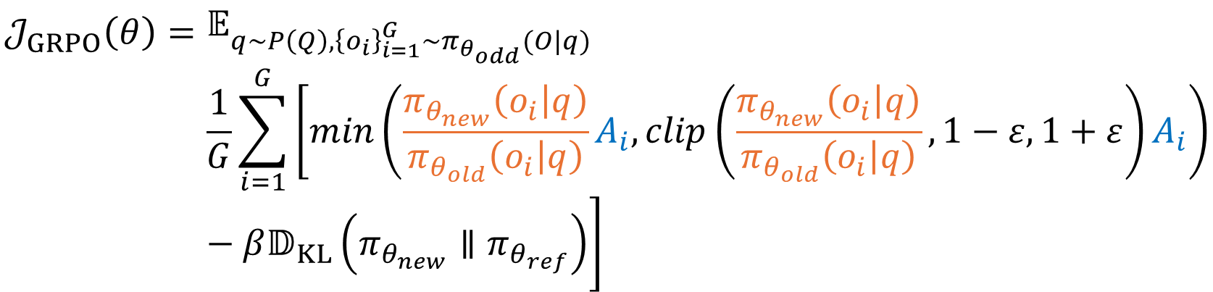
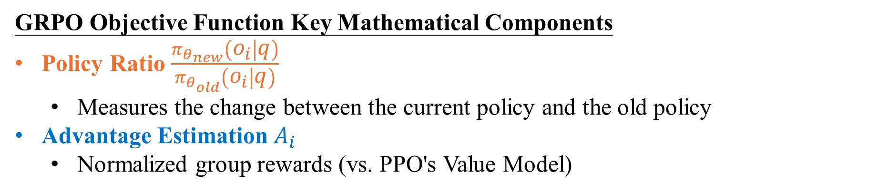
Method: Mathematical Core: GRPO Objective
$$𝒥_{GRPO}\left(θ\right)=$$ | $$𝔼_{q\sim P\left(Q\right),{\left\{o_{i}\right\}}_{i=1}^{G}\sim π_{θ_{odd}}(O|q)}$$
 | $$\frac{1}{G}\sum_{i=1}^{G}{\left[min⁡\left(\frac{π_{θ_{new}}\left(o_{i} | q\right)}{π_{θ_{old}}\left(o_{i} | q\right)}A_{i},clip\left(\frac{π_{θ_{new}}\left(o_{i} | q\right)}{π_{θ_{old}}\left(o_{i} | q\right)},1−ε,1+ε\right)A_{i}\right)−β𝔻_{KL}\left(π_{θ_{new}}∥π_{θ_{ref}}\right)\right]}$$
GRPO Objective Function Key Mathematical Components
Policy Ratio $\frac{π_{θ_{new}}\left(o_{i} | q\right)}{π_{θ_{old}}\left(o_{i} | q\right)}$
  Measures the change between the current policy and the old policy
Advantage Estimation$A_{i}$
  Normalized group rewards (vs. PPO's Value Model)
04/17

Slide 5
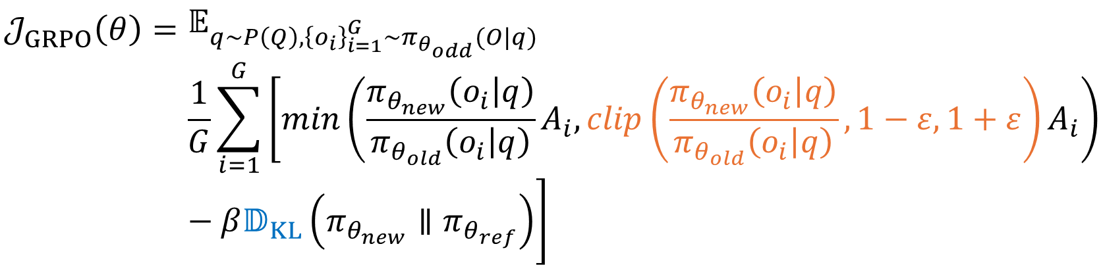
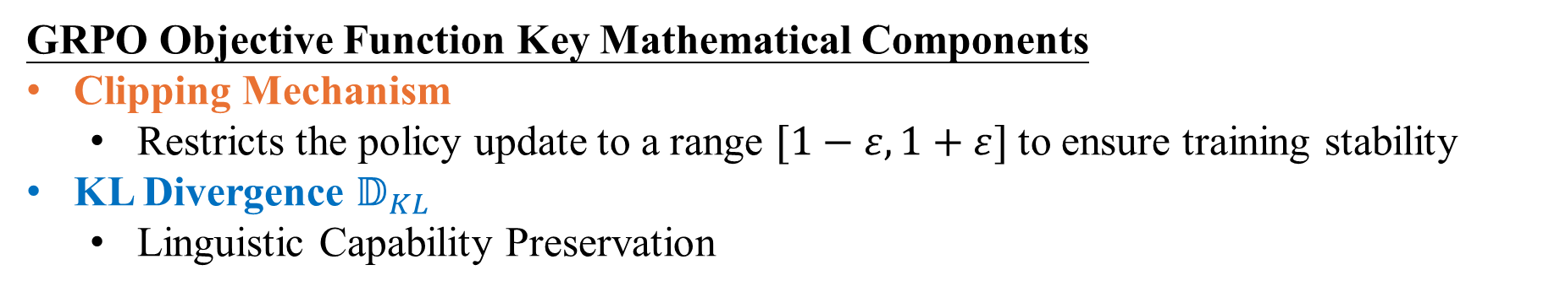
Method: Mathematical Core: GRPO Objective
$$𝒥_{GRPO}\left(θ\right)=$$ | $$𝔼_{q\sim P\left(Q\right),{\left\{o_{i}\right\}}_{i=1}^{G}\sim π_{θ_{odd}}(O|q)}$$
 | $$\frac{1}{G}\sum_{i=1}^{G}{\left[min⁡\left(\frac{π_{θ_{new}}\left(o_{i} | q\right)}{π_{θ_{old}}\left(o_{i} | q\right)}A_{i},clip\left(\frac{π_{θ_{new}}\left(o_{i} | q\right)}{π_{θ_{old}}\left(o_{i} | q\right)},1−ε,1+ε\right)A_{i}\right)−β𝔻_{KL}\left(π_{θ_{new}}∥π_{θ_{ref}}\right)\right]}$$
GRPO Objective Function Key Mathematical Components
Clipping Mechanism
  Restricts the policy update to a range $[1−ε, 1+ε]$to ensure training stability
KL Divergence $𝔻_{KL}$
  Linguistic Capability Preservation
05/17

Slide 6
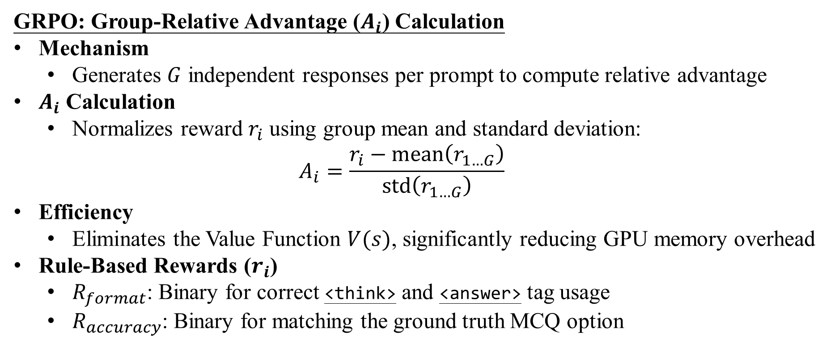
Method: Reward Logic & Advantage Calculation
GRPO: Group-Relative Advantage ($A_{i}$) Calculation
Mechanism
  Generates $G$ independent responses per prompt to compute relative advantage
$A_{i}$ Calculation
  Normalizes reward $r_{i}$ using group mean and standard deviation:
  $$A_{i}=\frac{r_{i}−\text{mean}\left(r_{1…G}\right)}{\text{std}\left(r_{1…G}\right)}$$
Efficiency
  Eliminates the Value Function $V(s)$, significantly reducing GPU memory overhead
Rule-Based Rewards ($r_{i}$)
  $R_{format}$: Binary for correct <think> and <answer> tag usage
  $R_{accuracy}$: Binary for matching the ground truth MCQ option
06/17

Slide 7
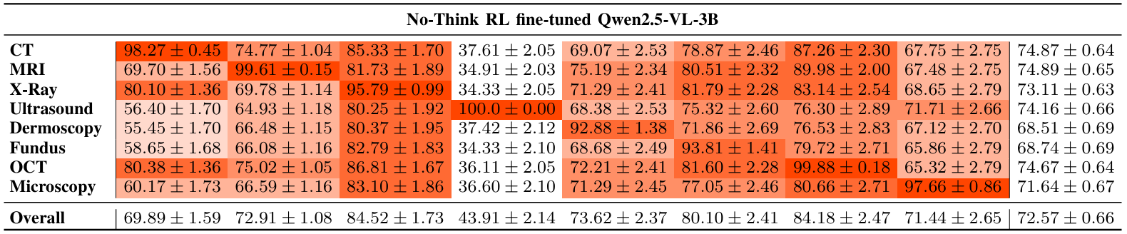
Performance Upper Bound: No-Think RL
❶
❷
❶ In-Domain Mastery (Diagonal)
  Achieving near-perfect scores
  Maximum capacity: Raw performance without reasoning overhead
❷ System-Wide Benchmark
  Theoretical Max: Unconstrained medical feature extraction
07/17

Slide 8
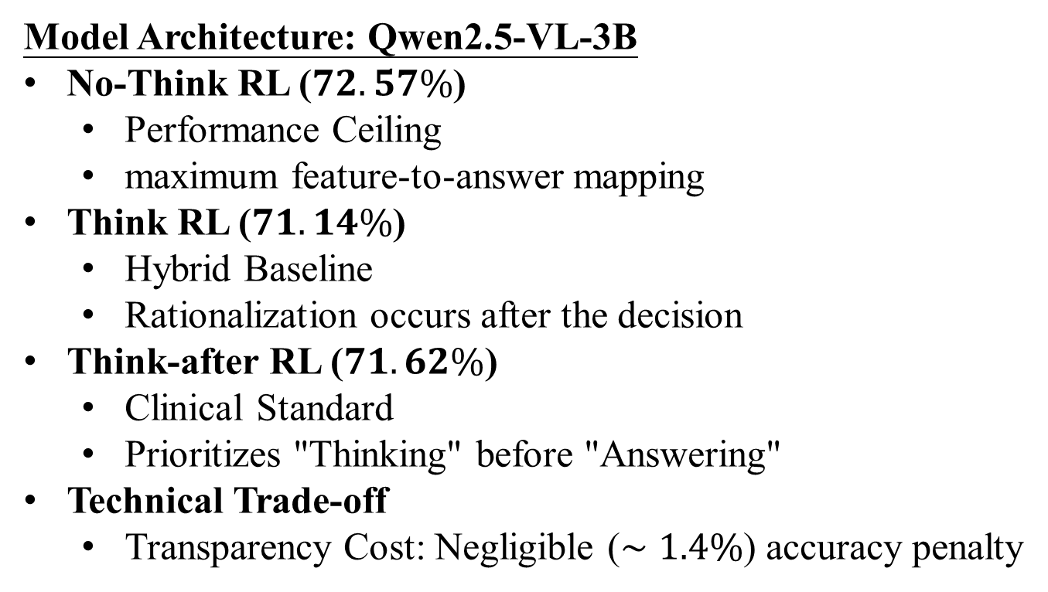
Result: Cross-Strategy Performance Comparison
Model Architecture: Qwen2.5-VL-3B
No-Think RL ($72.57\%$)
  Performance Ceiling
  maximum feature-to-answer mapping
Think RL ($71.14\%$)
  Hybrid Baseline
  Rationalization occurs after the decision
Think-after RL ($71.62\%$)
  Clinical Standard
  Prioritizes "Thinking" before "Answering"
Technical Trade-off
  Transparency Cost: Negligible ($∼1.4\%$) accuracy penalty
08/17
Notes:
ㄋ

Slide 9
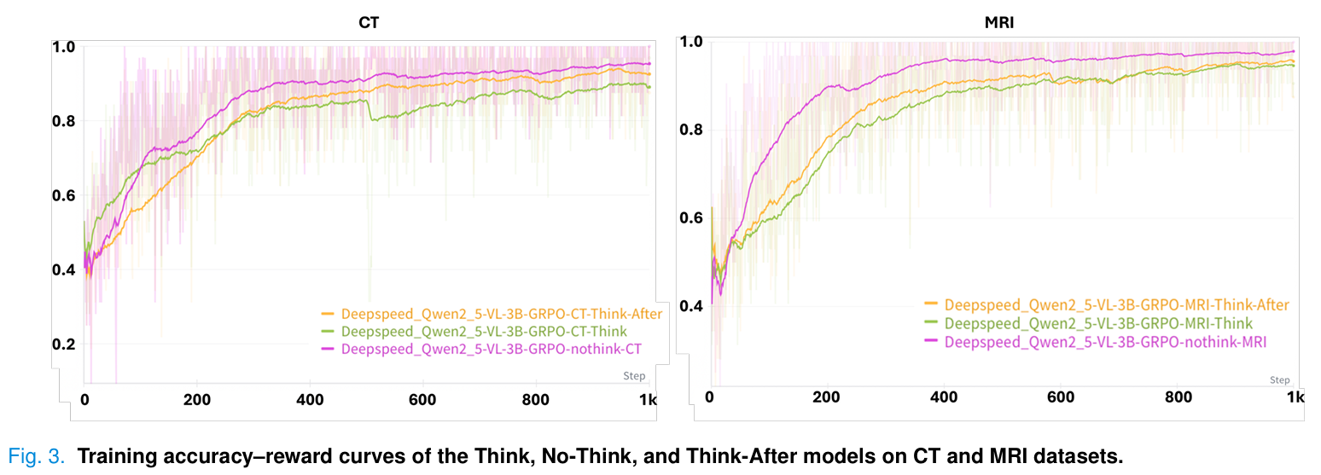
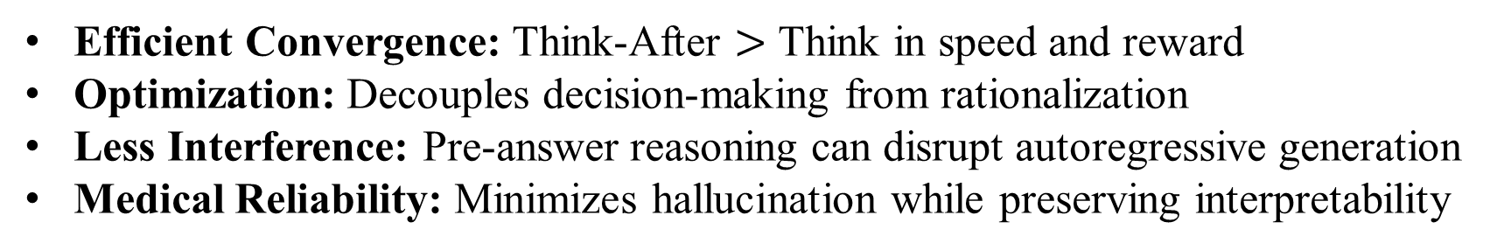
Result: Why "Think-After" Wins
Efficient Convergence: Think-After $>$ Think in speed and reward
Optimization: Decouples decision-making from rationalization
Less Interference: Pre-answer reasoning can disrupt autoregressive generation
Medical Reliability: Minimizes hallucination while preserving interpretability
09/17
Notes:
ㄋ

Slide 10
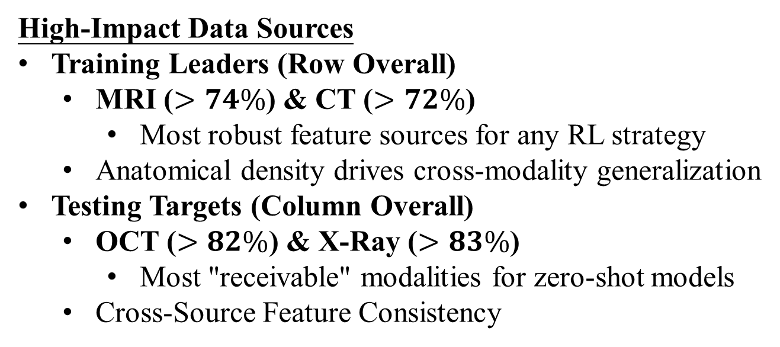
Consistency Analysis: Anchor Modalities
High-Impact Data Sources
Training Leaders (Row Overall)
  MRI ($>74\%$) & CT ($>72\%$)
    Most robust feature sources for any RL strategy
  Anatomical density drives cross-modality generalization
Testing Targets (Column Overall)
  OCT ($>82\%$) & X-Ray ($>83\%$)
    Most "receivable" modalities for zero-shot models
  Cross-Source Feature Consistency
10/17
Notes:
ㄋ

Slide 11
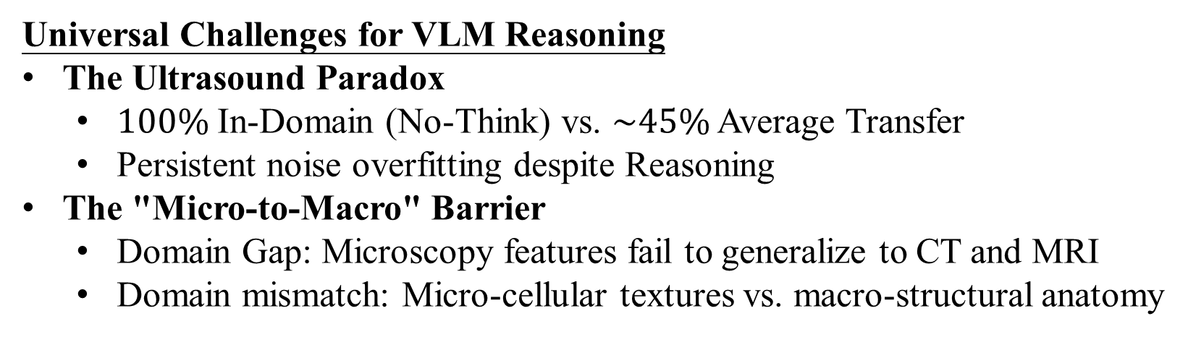
The Bottlenecks: Generalization Gaps
Universal Challenges for VLM Reasoning
The Ultrasound Paradox
  $100\%$ In-Domain (No-Think) vs. $\sim 45\%$ Average Transfer
  Persistent noise overfitting despite Reasoning
The "Micro-to-Macro" Barrier
  Domain Gap: Microscopy features fail to generalize to CT and MRI
  Domain mismatch: Micro-cellular textures vs. macro-structural anatomy
11/17
Notes:
ㄋ

Slide 12
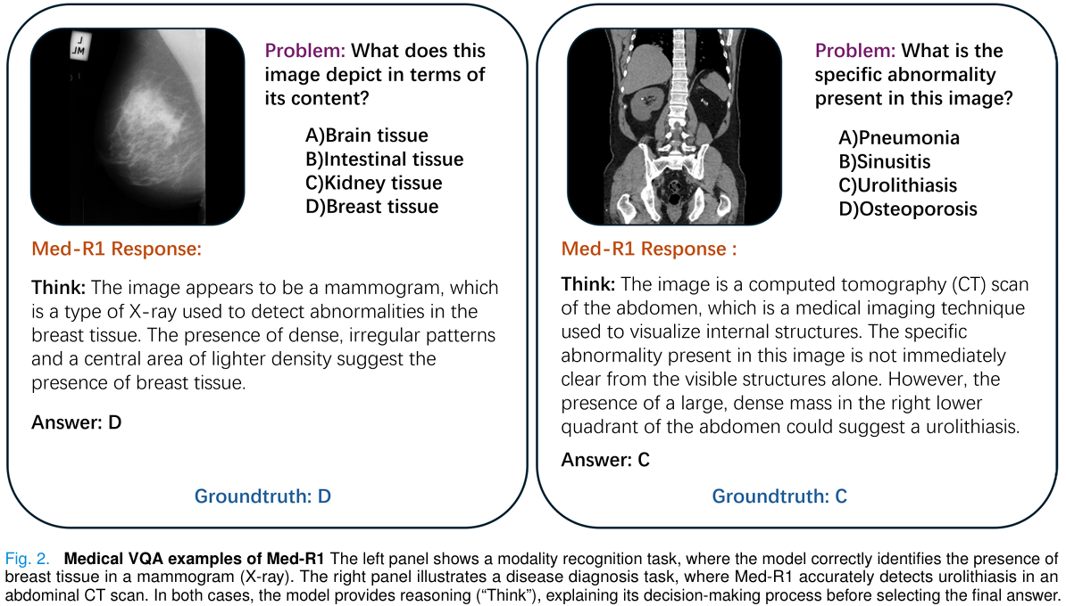
Qualitative Analysis: Case Study
Traceable Logic: Shows <think> process from visual features to diagnosis
Expert Alignment: Reasoning paths follow clinical standards
Error Correction: RL helps the model refine its path through trial and error
12/17
Notes:
ㄋ

Slide 13
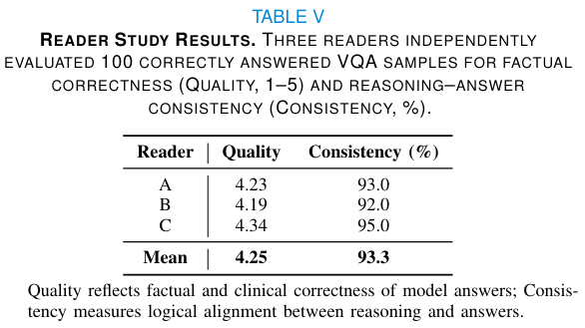
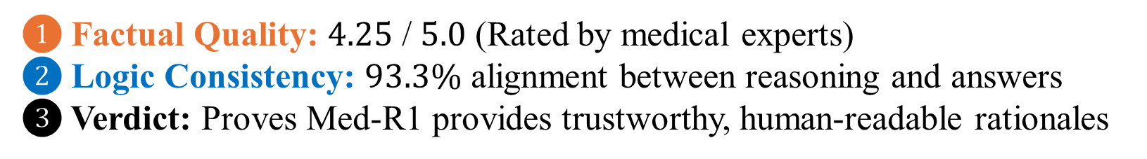
Clinical Validation: Reader Study
❶
❷
❶ Factual Quality: $4.25$ / $5.0$ (Rated by medical experts)
❷ Logic Consistency: $93.3\%$ alignment between reasoning and answers
❸ Verdict: Proves Med-R1 provides trustworthy, human-readable rationales
13/17
Notes:
ㄋ

Slide 14
Conclusion
Core Contributions
Scalable RL Framework
  Proves GRPO enables 3B models to surpass 72B
Paradigm Shift
  Think-After decouples decision from reasoning
Generalization Leader
  New benchmark for cross-modality reasoning
Future Directions
From 2D to 3D or Video
  Supporting Volumetric CT and MRI and Ultrasound
Clinical Context
  Incorporating patient history and EHR data
14/17
Notes:
ㄋ

Slide 15
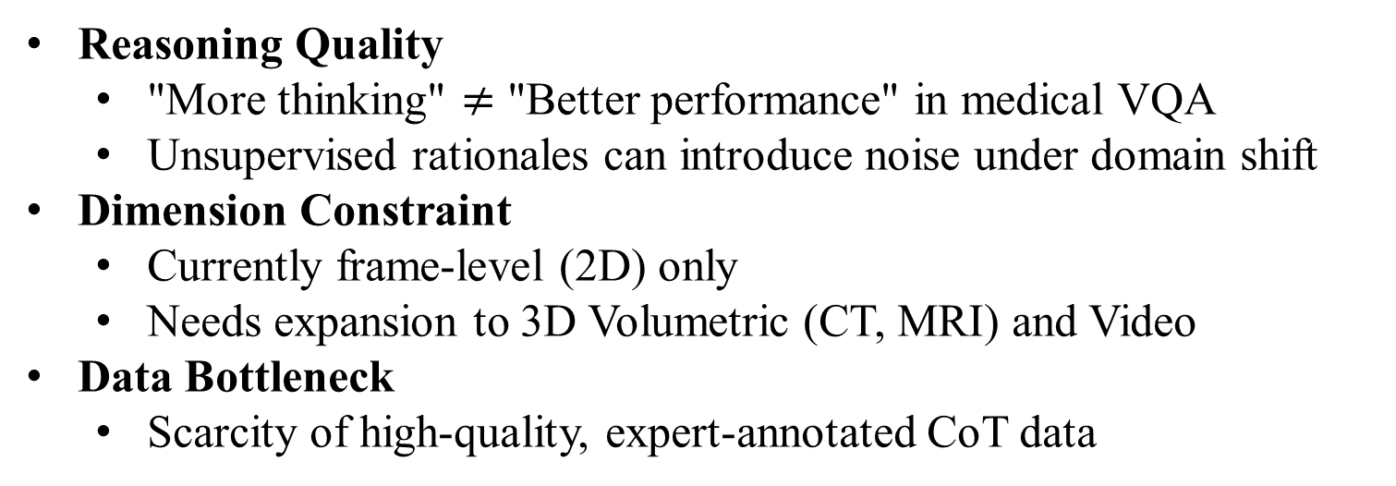
arXiv:1802.05695
arXiv:1802.05695
Discussion & Limitations
Reasoning Quality
  "More thinking" $≠$ "Better performance" in medical VQA
  Unsupervised rationales can introduce noise under domain shift
Dimension Constraint
  Currently frame-level (2D) only
  Needs expansion to 3D Volumetric (CT, MRI) and Video
Data Bottleneck
  Scarcity of high-quality, expert-annotated CoT data
15/17

Slide 16
arXiv:1802.05695
arXiv:1802.05695
My Insights & Critique
Accuracy vs. Reasoning Gap
  Accuracy vs. Reasoning Gap
    Reasoning does not always improve prediction
Post-hoc Explanation Risk
  Think-After: Prediction → Reasoning
    Explanation may not reflect true reasoning
Dataset Limitation: OmniMedVQA
  Mostly MCQ-style VQA tasks focus on recognition rather than diagnosis
Future Direction
  More complex clinical tasks
  Integration with patient context / EHR
16/17

Slide 17
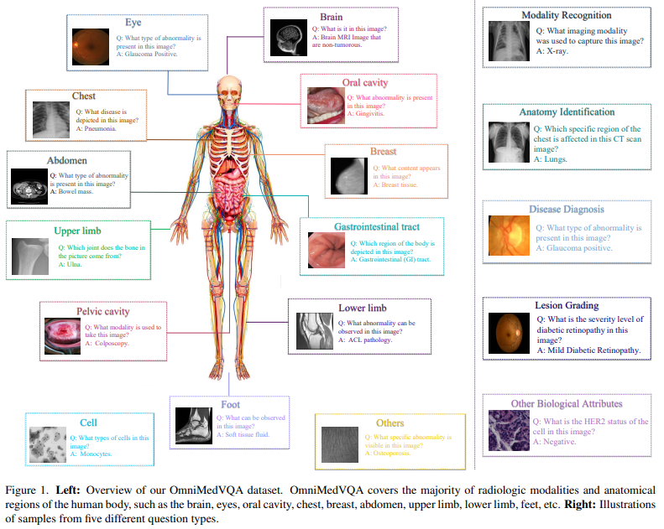
arXiv:1802.05695
arXiv:1802.05695
The OmniMedVQA Dataset Sample
Y. Hu, T. Li, Q. Lu, W. Shao, J. He, Y. Qiao, and P. Luo, “OmniMedVQA: A New Large-Scale Comprehensive Evaluation Benchmark for Medical LVLM,” in Proc. IEEE/CVF Conf. Computer Vision and Pattern Recognition (CVPR), 2024, pp. 22170–22183
17/17

